Slide 1

🚀 AI-Powered Employee Role Recommendation System
This innovative Streamlit application empowers HR analysts and product managers to match employees to optimal roles using AI-driven skill analysis. By uploading datasets, users can explore personalized recommendations, identify skill gaps, and generate actionable learning paths for career development. Built for hackathon excellence, it transforms HR data into strategic insights.

Slide 2



🎯 The Problem We Solve
In today's dynamic workforce, aligning employee skills with evolving job roles is challenging. Traditional methods rely on manual reviews, leading to inefficiencies, talent mismatches, and missed growth opportunities. Our system addresses this by automating skill-role matching, providing data-driven recommendations to optimize talent placement and boost retention by up to 30% based on industry benchmarks.
Key Challenges
Skill gaps hinder promotions; outdated data causes poor hires.
Business Impact
Reduces turnover costs and accelerates internal mobility.

Slide 3
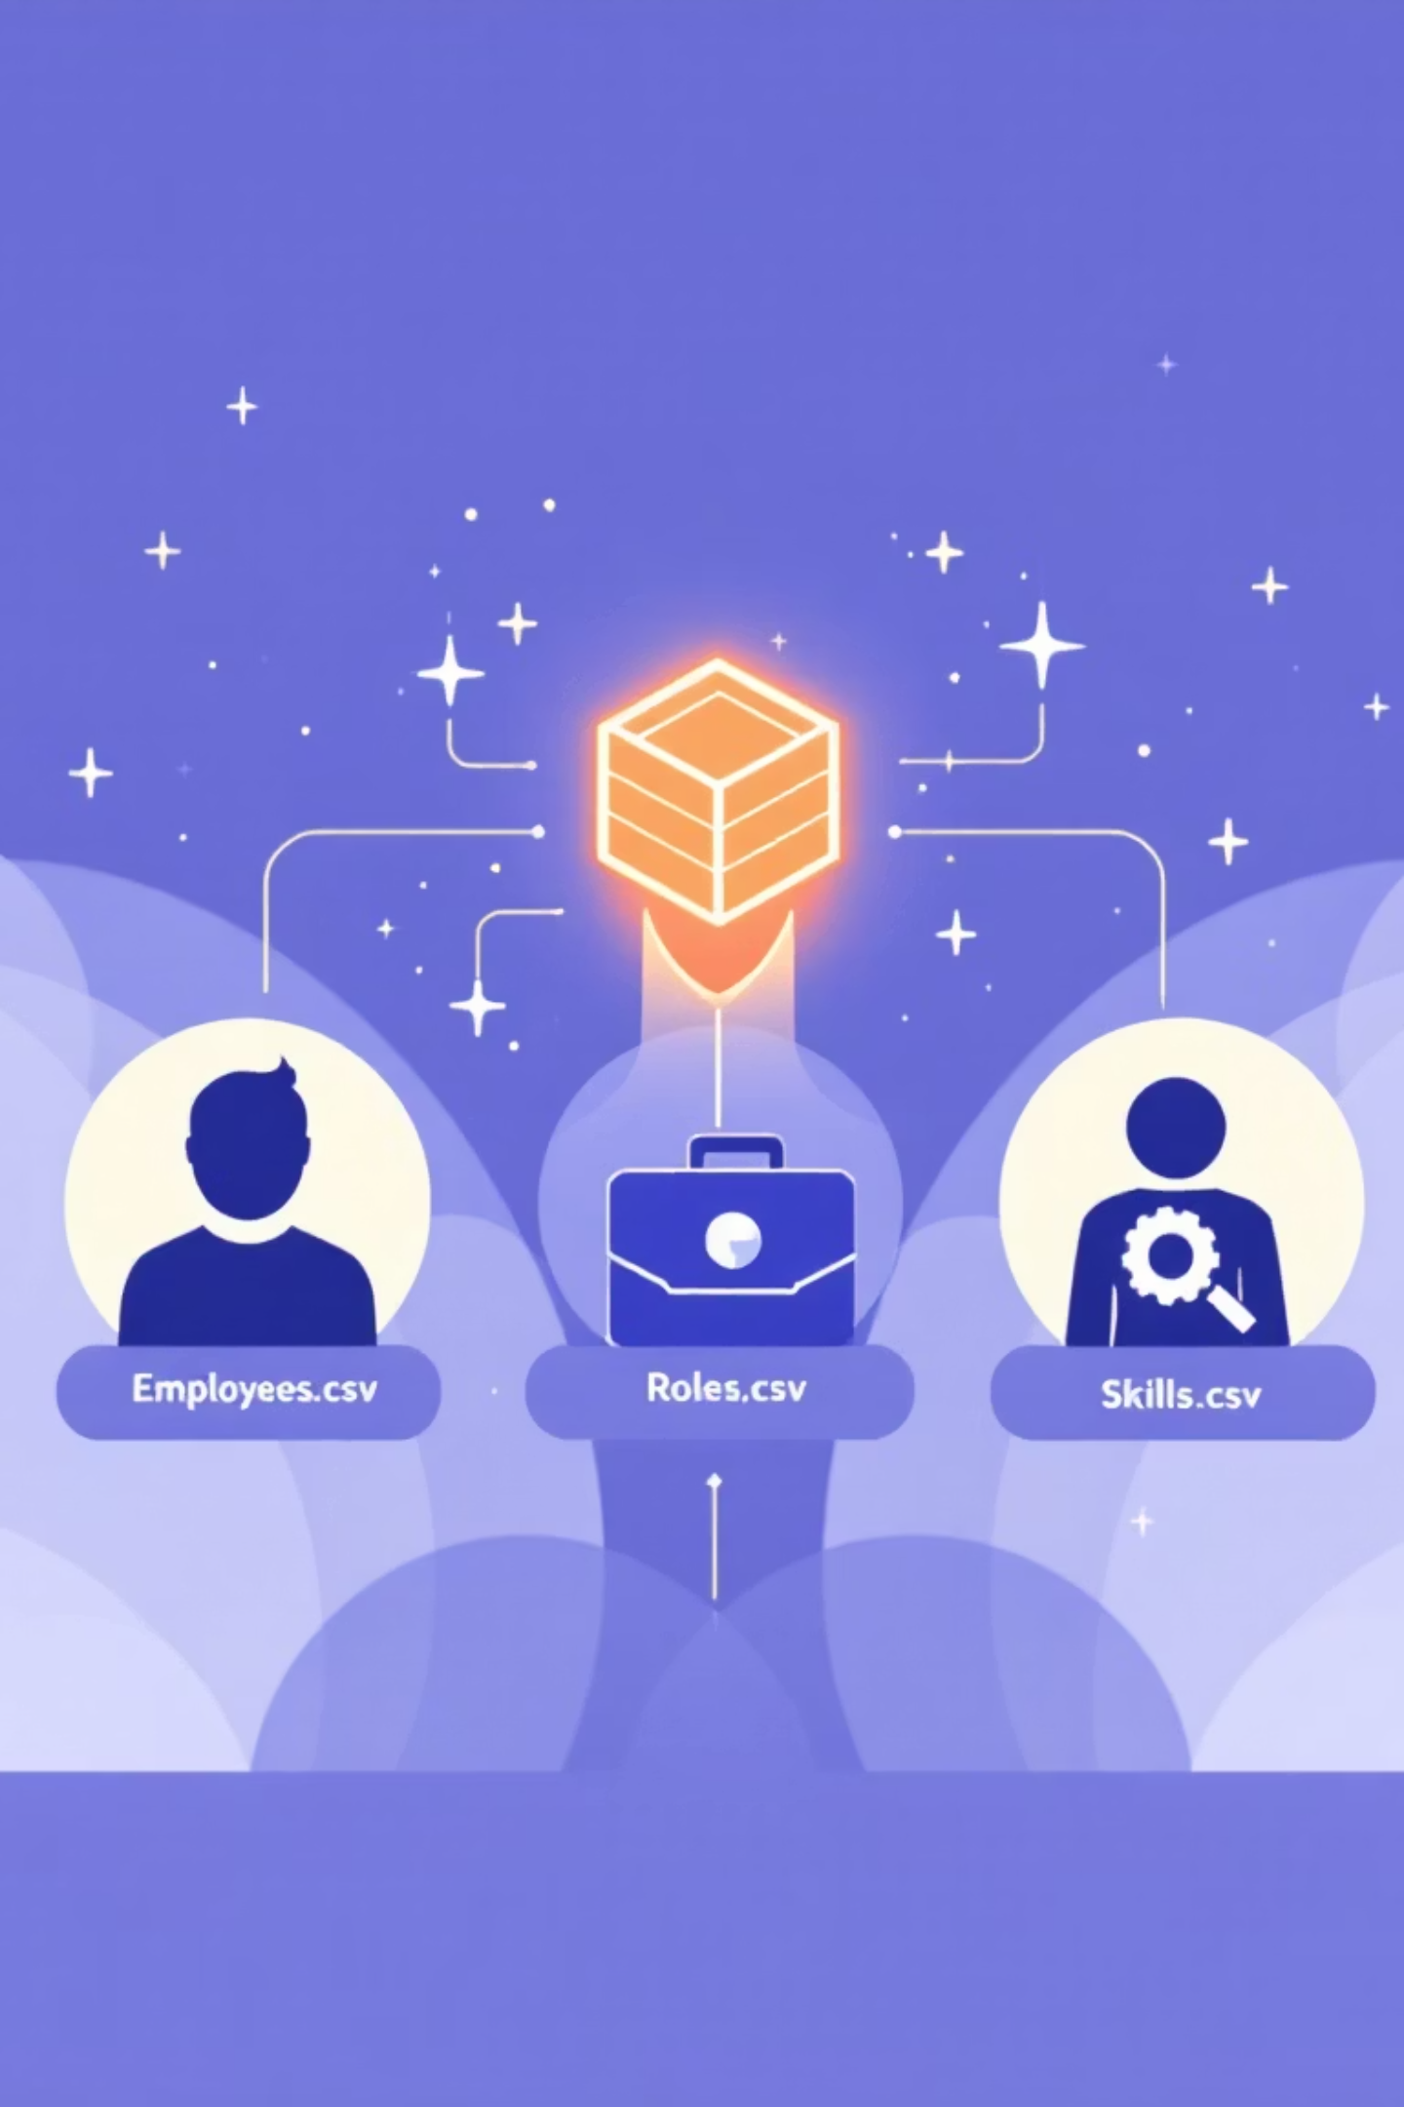
📊 Data Foundation: Key Datasets
Our system processes five core CSV files to build a robust knowledge base. These datasets capture employee profiles, role requirements, and skill inventories, enabling precise matching algorithms. Sourced from HR analytics and job postings, they ensure comprehensive coverage for realistic recommendations.
Employees.csv
Roles.csv
Skills.csv & EmployeeSkills.csv
200 employee records with IDs, original EmpIDs, and current roles. Limited for performance; sampled randomly from HR_Analytics.csv.
Job postings data with role IDs, names, and external links. Deduplicated for unique opportunities from job_postings.csv.
Unique skills extracted from job_skills.csv (e.g., Python guaranteed). Randomly assigned 5-15 skills per employee for simulation.

Slide 4

🔧 Automated Data Generation Pipeline
The backend script automates CSV creation from raw sources like HR_Analytics.csv, job_postings.csv, and job_skills.csv. It processes skills into unique lists, limits employee data for efficiency, assigns random skills, and computes recommendations—streamlining setup for rapid deployment in hackathon environments.
Step 1: Extract Skills
Parse job_skills.csv, deduplicate, and add essentials like Python. Generate Skills.csv with IDs and names.
Step 2: Build Roles & Employees
Create Roles.csv from job postings; sample 200 employees from HR data into Employees.csv with standardized IDs.
Step 3: Assign & Match
Randomly assign skills to employees; compute matches for Recommendations.csv, including matched/missing skills.

Slide 5
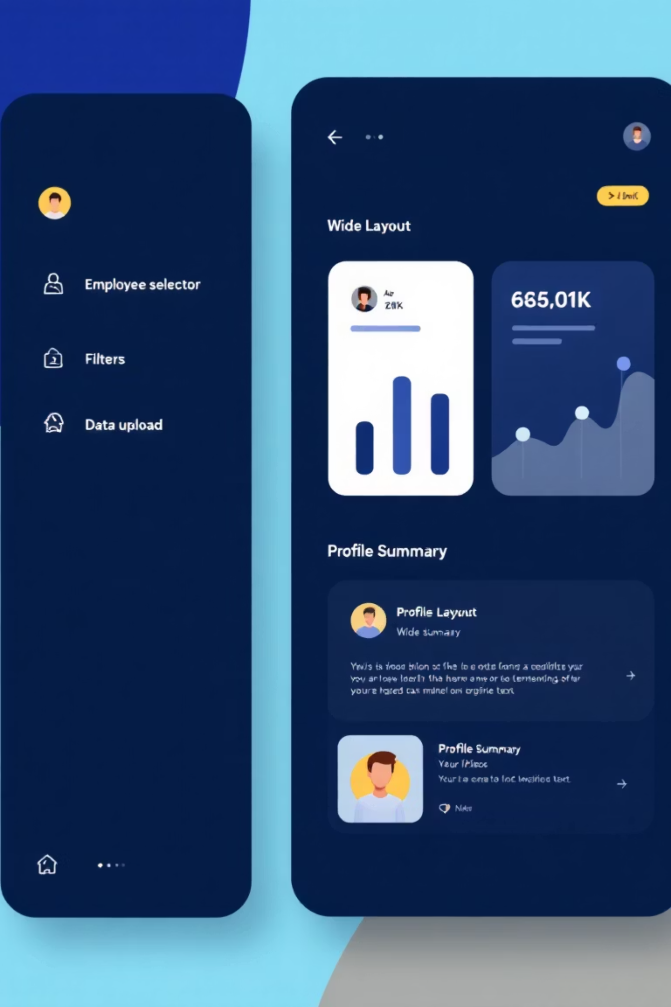
💻 Streamlit App: Core Interface
Launch the app with wide layout for immersive analysis. Users select employees via sidebar, view profiles, and upload custom CSVs/PDFs for recommendations. Cached data loading ensures speed, while helper functions enable seamless CSV exports—making it intuitive for HR analysts to dive into insights without coding expertise.
Page config sets title and wide view for optimal display.
Sidebar includes employee selector, profile summary (ID, role, top 15 skills), and default top-5 recommendations.
Supports PDF text extraction via pdfplumber for flexible data ingestion.

Slide 6
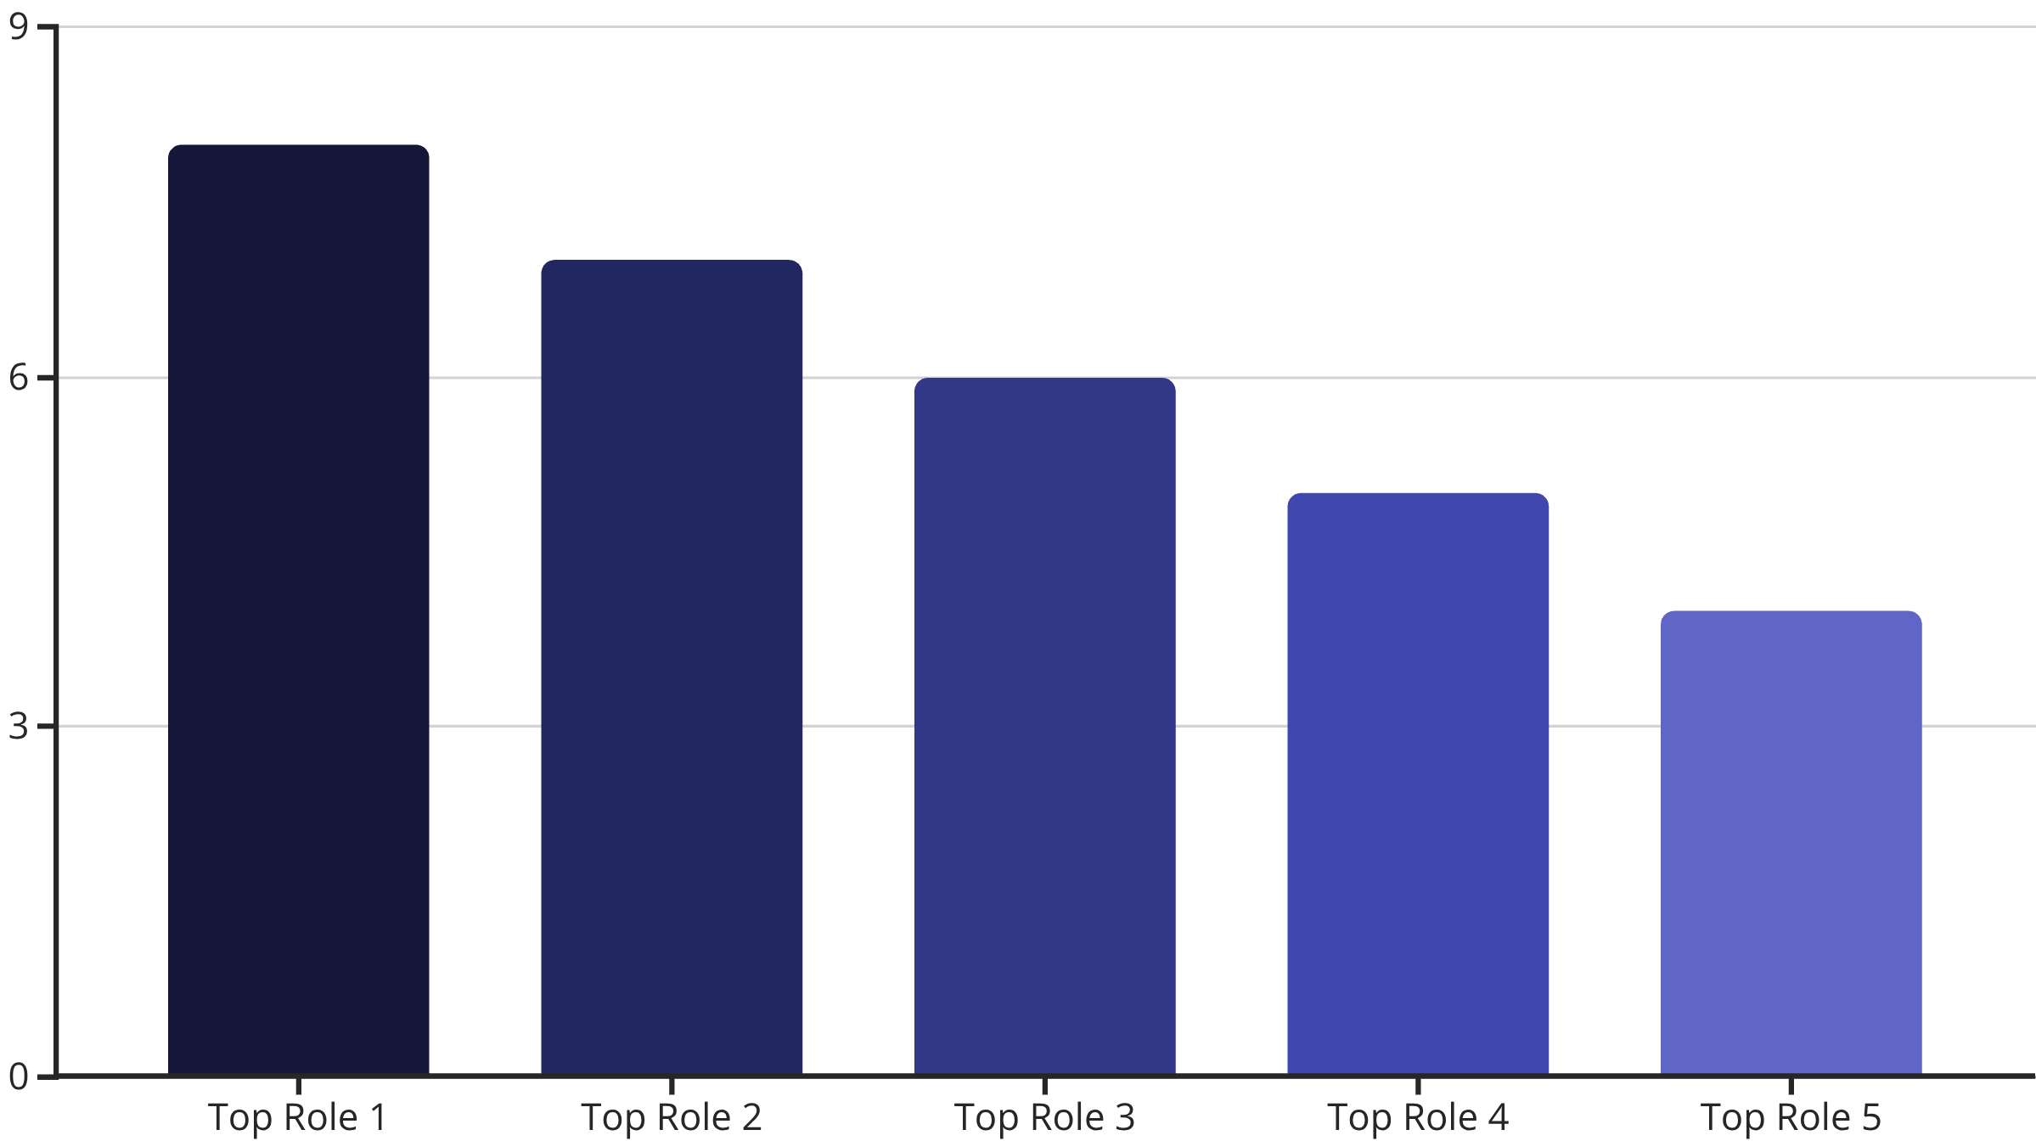
📌 Top Role Recommendations
View personalized top-5 roles sorted by match score for the selected employee. The dataframe displays role ID, score, matched skills, and gaps. Upload custom data for on-the-fly analysis—empowering quick decisions for promotions or reassignments with visual summaries of fit.
Sample scores highlight strong fits; green indicates high potential matches.

Slide 7

🎯 In-Depth Skill Gap Analysis
Select from top recommendations to analyze skill breakdowns. The horizontal bar chart stacks matched (green) and missing (red) skills, with total requirements noted. Columns list specifics, guiding targeted training—essential for bridging gaps and preparing employees for new roles efficiently.
Visual Breakdown
Actionable Insights
Match score: e.g., 7.5/10. Total skills required: 12. Matched: 8 (e.g., Python, SQL). This interactive view uses Seaborn for clarity.
Missing skills trigger learning paths. Dual-column layout ensures balanced readability for quick scans during reviews.
Enhance decisions with precise, color-coded gap identification.

Slide 8






📊 Match Score Insights & Matrix
Explore overall match distributions via histograms (blue for all pairs, orange dashed for selected employee). The interactive high-contrast heatmap (magma colormap) visualizes skill presence across filtered employees and skills—defaulting to the current user's profile for contextual depth.
Heatmap
Multiselect filters for employees/skills; annotates 0/1 presence.
Distribution
Histograms reveal score patterns; highlights top employee fits.
Benefits
Spot trends in talent distribution for strategic HR planning.

Slide 9
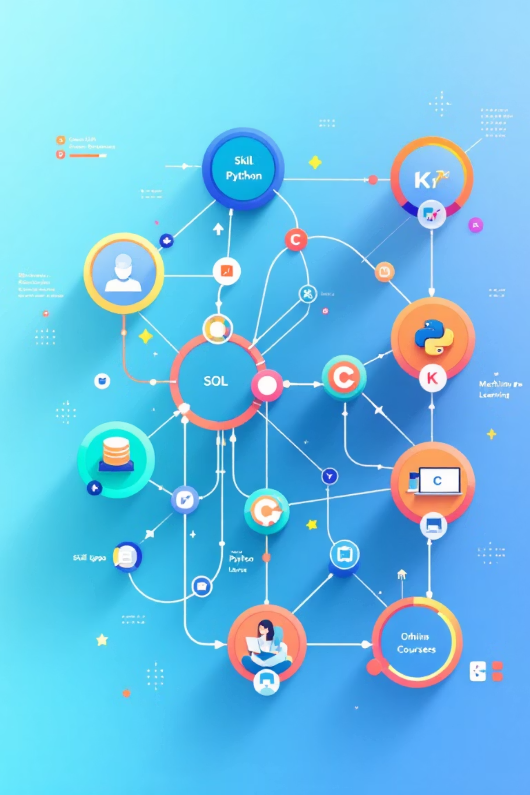
🚀 Unique Feature: Learning Paths
Our standout innovation generates tailored learning paths for missing skills in JSON format (LearningPaths.json). For each recommendation, it maps gaps to resources like Coursera for Machine Learning or Kaggle for Python—transforming analysis into actionable development plans to accelerate career growth.
Predefined resources for key skills (SQL, Excel, Tableau, etc.); extensible for custom additions.
Output integrates easily with frontends, providing links like "https://www.coursera.org/learn/machine-learning".
Ensures every gap has a path, even noting "add manually" for unknowns—proactive IDP support.

Slide 10

⬇️ Export & Next Steps
Download full recommendations or employee-specific CSV files for offline analysis or integration. This hackathon-ready tool scales for enterprise use, reducing HR workload while fostering talent development. Future enhancements: AI predictions and real-time integrations.
200
100%
5
Employees Processed
Skill Coverage
Downloads Available
Sampled dataset for fast insights; scalable to full HR systems.
Guaranteed key skills like Python; comprehensive matching.
Full and personalized exports for seamless workflows.
Ready to deploy—empower your team today!

